Slide 1
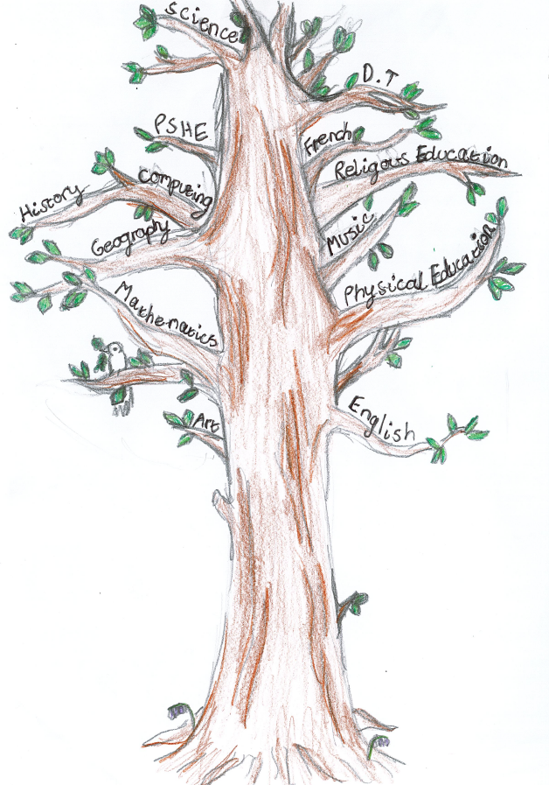





Year 3 Autumn 1
In English we will be reading 'Stone Age Boy'. We will be creating reports about The Stone Age and writing diary extracts. We will also focus on spelling and grammar rules.
Bookshelf
In History, we will be exploring what life was like for humans living in The Stone Age, including finding out how life changed during that period of time.
In Maths, we will be investigating the place value of 2 and 3 digit numbers. We will also work on strategies to add and subtract these numbers.
In RE, we will we will be exploring the question ' What do some Christians learn from the creation story?'
In Science, our topic is 'Animals, including humans'. Pupils will explore nutrition, skeletons and muscles and will be develop their working scientifically skills.
In Computing, we will work on our word-processing skill by starting to learn touch typing. We will also create presentations in power point.
In PE we will be working on flexibility, core strength and mindfulness by learning Yoga. We will also work on the fundamentals of PE such as developing balance, agility and control.
In Art we will be discovering how and why our ancient ancestors made art, experimenting with natural materials to make homemade paints and playing with scale when painting on different surfaces.
In PSHE/RSHE, we will be considering how we connect with other people. We will explore what helps us feel safe and included.
In Music, we will be studying and performing ballads.

Slide 2


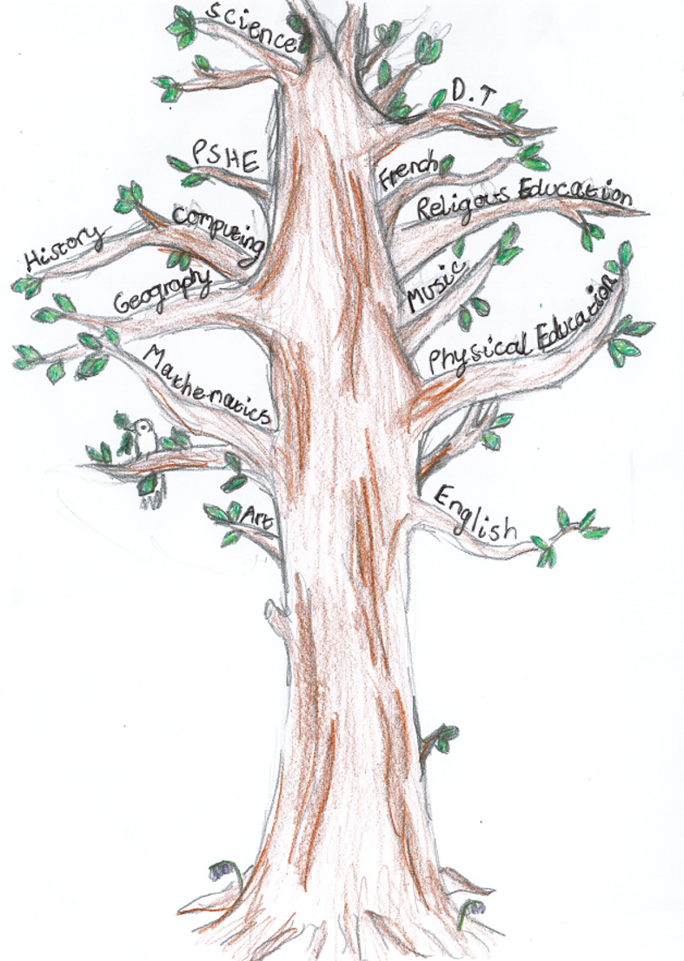

Welcome to Year 3! We hope you have all had a wonderful summer break and your child is feeling refreshed and ready for an exciting term ahead. We are looking forward to getting to know your children, supporting them as they settle into Key Stage 2 and inspiring them to achieve their potential.
Please encourage your child to read for 30 minutes each day. Thank you for your continued support, which has helped many children make excellent progress in reading. Reading books should be brought to school every day and kept clean, dry and safely stored in book bags.
Please label all clothing and equipment, tie back long hair, and ensure children wear full school uniform. Let the office know of any changes to collection arrangements.
Children may bring a healthy snack (preferably fruit) and should bring a named water bottle containing water only each day.
PE will be on Tuesdays and Thursdays. Children should come to school in their PE kit (red school jumper/hoodie with black or grey joggers/leggings and trainers). Please ensure they are dressed appropriately for the weather. Forest School will be on alternate Thursday mornings.
We are really looking forward to our Stone Age Experience Day on Tuesday 29th September.
Children are welcome to come to school dressed as if they were from The Stone Age. There is no charge for this day.
Homework will be given out on Friday and is due back the following Friday It will be Literacy, Maths or Topic based. Your child will also have a short spelling activity to complete.
If you have any queries please e-mail: admin@stgeorgesce.worcs.sch.uk
We aim to respond within 2 working days. If it is urgent, please speak to the school office directly.

